Slide 1
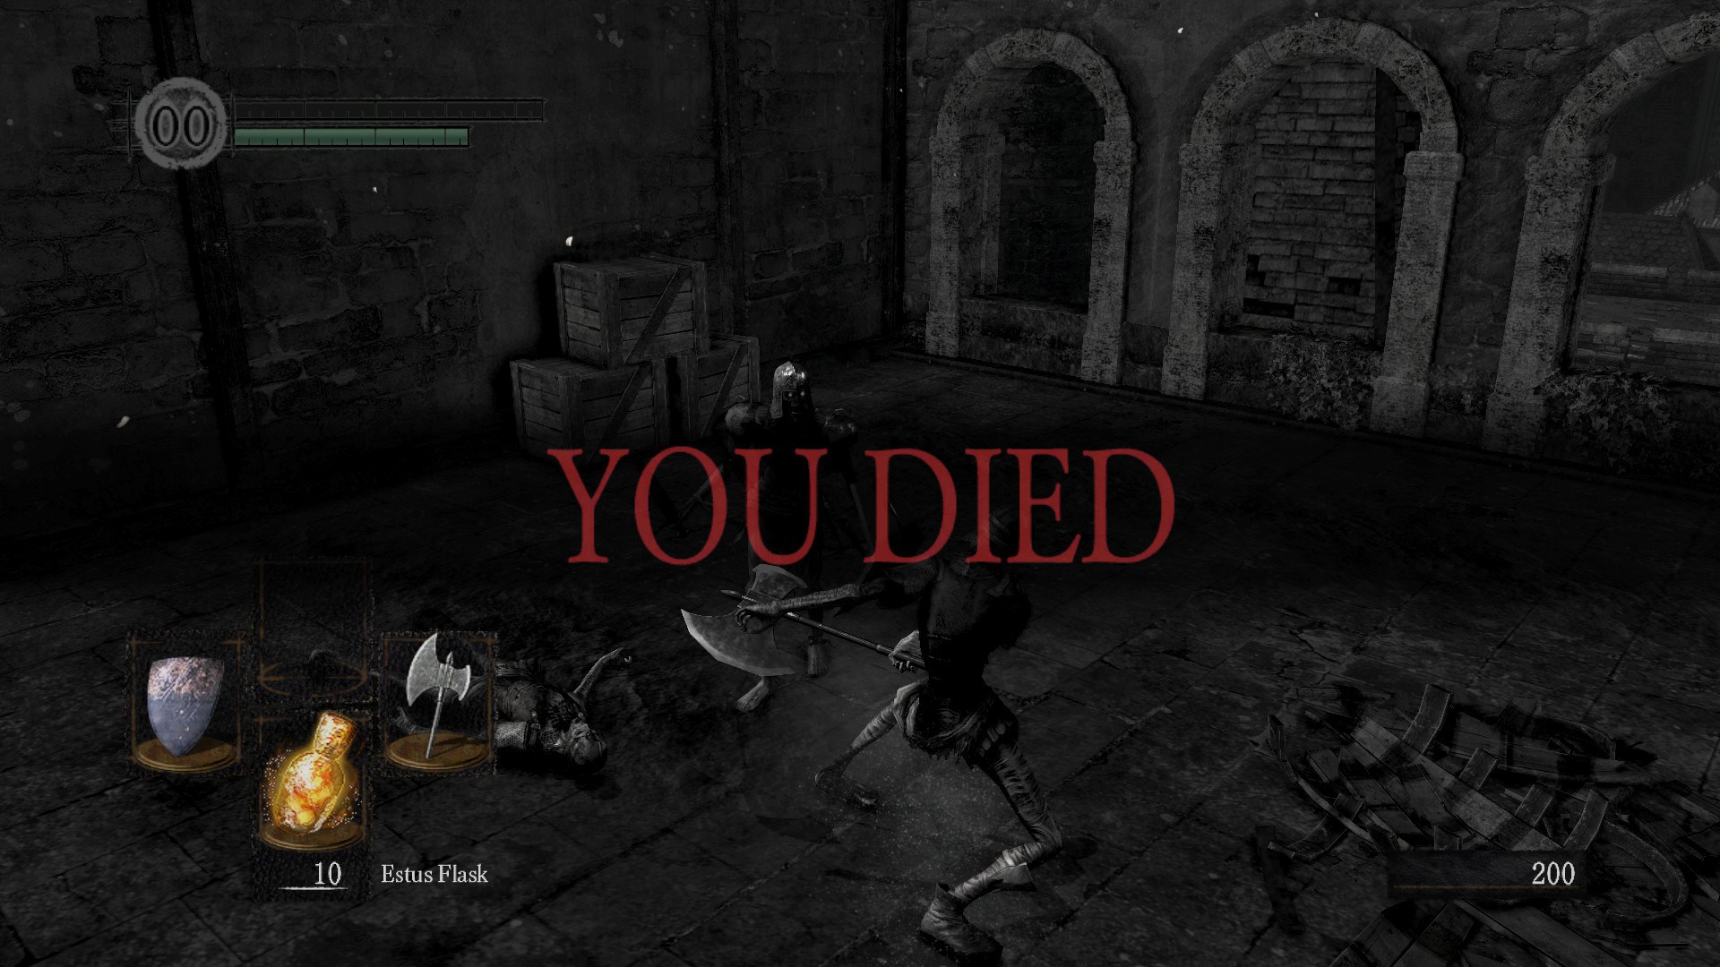



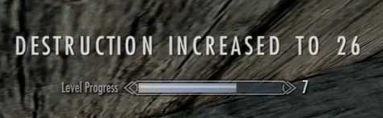
Digital Violence – Video games and VR
Longsen Lo, Ian Pashke, Garrett Spoke, Scott Sukkert, Chee Thao
HP
Description:
Performing violent acts through video games and living out another life or fantasy without real life consequences
VR allows you to perform the actual physical movements and not just point and clicking
Uniqueness:
Allows people to live out violent lives without performing any real violence.
Can be accessed and played by anyone, no age protection online to stop underage people from viewing
Anything can be created and simulated
Ethical Analysis:
Utilitarian- Video games allow for entertainment and living out a fantasy that isn’t possible in the real world
Deontology- To stop the spread of violence and protect the younger generations from becoming violent
Virtue- To be a good person even in the virtual world
Conceptual Muddles & Policy Vacuums:
Video games were created for entertainment and not the spread of violence
Lack of laws for controlling violence in video game communities
Core Ethical Concerns:
Video games created about sensitive real world events
Could influence real world violence
Lack of parental supervision
Video games becoming too realistic
Strategies to address the Ethical Concerns:
Strict VS lenient ESRB (Entertainment Software Rating Board) – age verification for online purchases
Teaching proper online etiquette at an early age
More prominent disclaimer for violence in gameplay
Notes:
Gorn trailer (VR gladiator) - https://www.youtube.com/watch?v=M_h3mIUrytE
Killing Floor: Incursion - https://www.youtube.com/watch?v=JBAB8U1o6DI
Doom - https://www.youtube.com/watch?v=RO90omga8D4&has_verified=1
Doom Glory Kills Compilation - https://www.youtube.com/watch?v=DB1uqOaY61w
God of War Finishers - https://www.youtube.com/watch?v=eN-0e0R60G4

